Slide 1
Chap 8. File Processing and External Sort

Slide 2
Primary vs. Secondary Storage
Primary storage: Main memory (RAM)
Secondary Storage: Peripheral devices
  Disk drives
  Tape drives

Slide 3
Comparisons (per MB)
Medium | Early 1996 | Mid 1997 | Early 2000
RAM | $45.00 | 7.00 | 1.50
Disk | 0.25 | 0.10 | 0.01
Floppy | 0.50 | 0.36 | 0.25
Tape | 0.03 | 0.01 | 0.001
Now $0.02/MB
RAM is usually volatile(易失性).
RAM is about 1/4 million times faster than disk.

Slide 4
Golden Rule of File Processing
Minimize the number of disk accesses!
  1. Arrange information so that you get what you want with few disk accesses.
  2. Arrange information to minimize future disk accesses.
An organization for data on disk is often called a file structure.
Disk-based space/time tradeoff: Compress information to save processing time by reducing disk accesses.

Slide 5
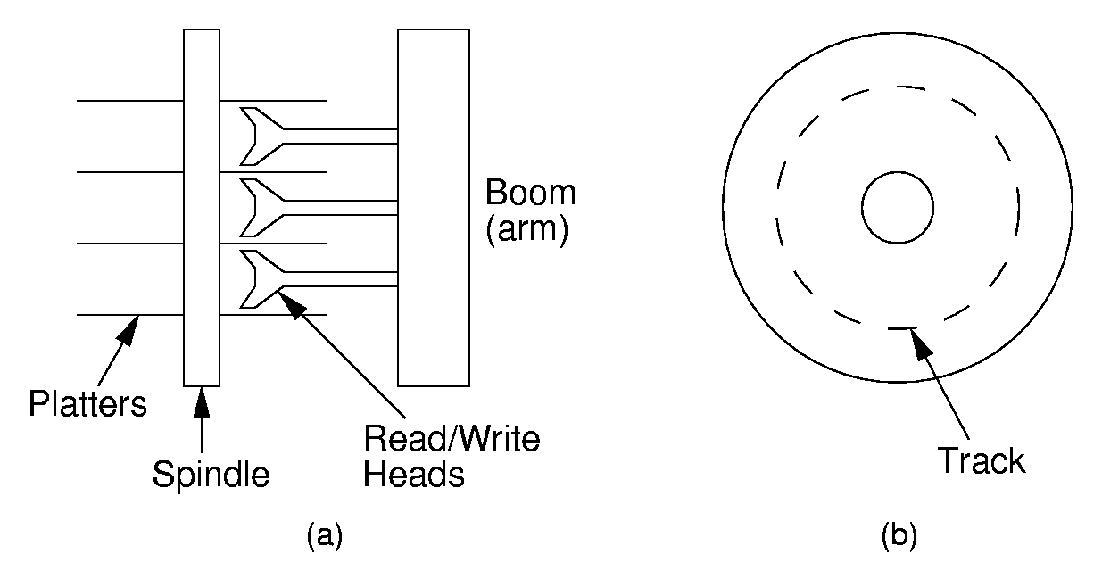
Disk Drives

Slide 6
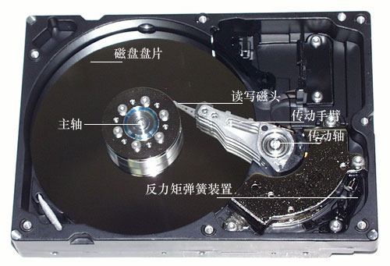

Slide 7
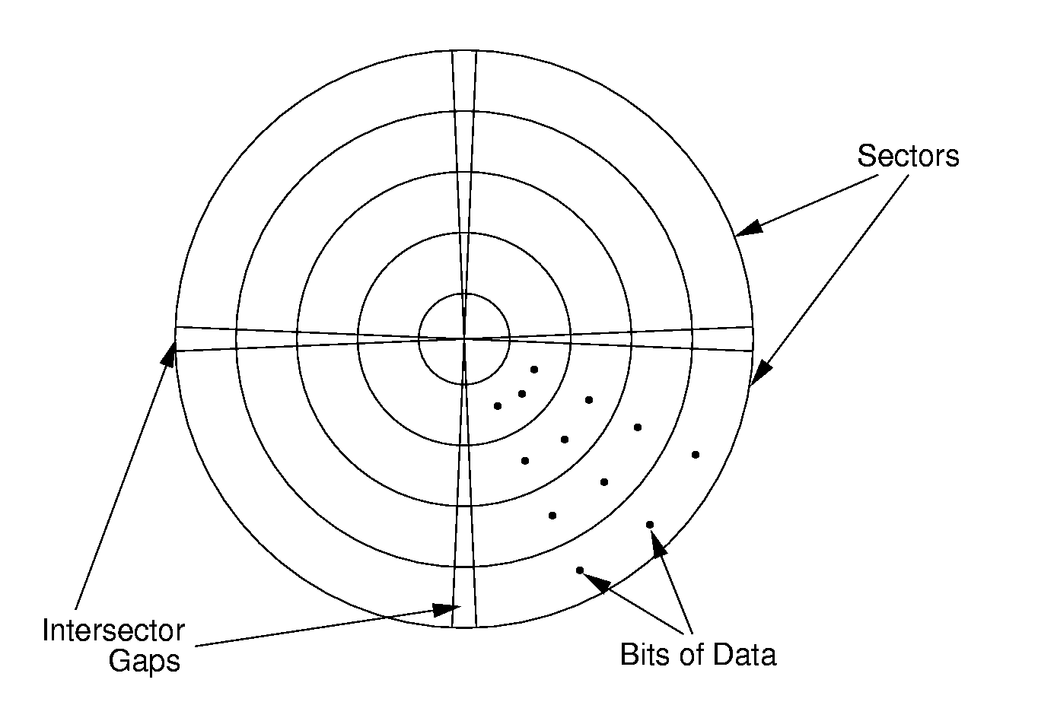
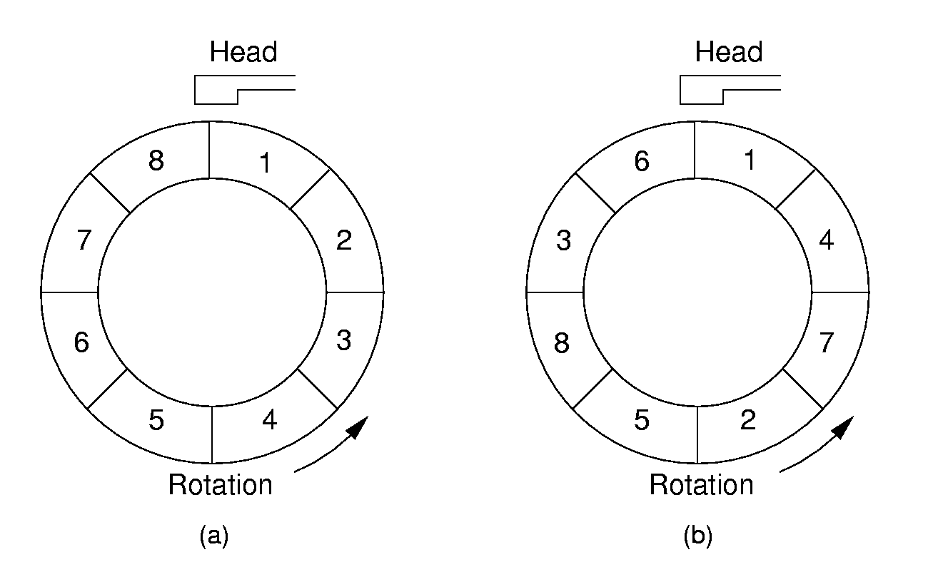
Sectors
A sector is the basic unit of I/O.
Interleaving factor: Physical distance between logically adjacent sectors on a track.

Slide 8
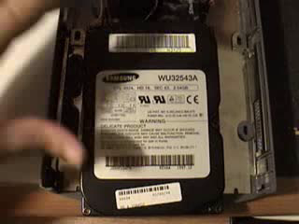

Working of Hard Disk

Slide 9
Terms
Locality of Reference(引用的局部性): When record is read from disk, next request is likely to come from near the same place in the file.
Cluster(簇): Smallest unit of file allocation, usually several sectors.
Extent(范围): A group of physically contiguous clusters.
Internal fragmentation(内部碎片): Wasted space within sector if record size does not match sector size; wasted space within cluster if file size is not a multiple of cluster size.

Slide 10
Seek Time
Seek time: Time for I/O head to reach desired track. Largely determined by distance between I/O head and desired track.
Track-to-track time: Minimum time to move from one track to an adjacent track.
Average Seek time: Average time to reach a track for random access.

Slide 11
Other Factors
Rotational Delay or Latency: Time for data to rotate under I/O head.
  One half of a rotation on average.
  At 7200 rpm, this is 8.3/2 = 4.2ms.
Transfer time: Time for data to move under the I/O head.
  At 7200 rpm:
    Number of sectors read/Number of sectors per track * 8.3ms.<number>

Slide 12
Disk Spec Example
16.8 GB disk on 10 platters = 1.68GB/platter
13,085 tracks/platter
256 sectors/track
512 bytes/sector
Track-to-track seek time: 2.2 ms
Average seek time: 9.5ms
4KB clusters, 32 clusters/track.
Interleaving factor of 3.
5400RPM

Slide 13
Disk Access Cost Example (1)
Read a 1MB file divided into 2048 records of 512 bytes (1 sector) each.
Assume all records are on 8 contiguous tracks.
First track: 9.5 + 11.1/2 + 3 x 11.1 = 48.4 ms
Remaining 7 tracks: 2.2 + 11.1/2 + 3 x 11.1 = 41.1 ms.
Total: 48.4 + 7 * 41.1 = 335.7ms

Slide 14
Disk Access Cost Example (2)
Read a 1MB file divided into 2048 records of 512 bytes (1 sector) each.
Assume all file clusters are randomly spread across the disk.
256 clusters. Cluster read time is
(3 x 8)/256 of a rotation for about 1 ms.
256(9.5 + 11.1/2 + (3 x 8)/256) is about 3877 ms. or nearly 4 seconds.
Notes:
This is MUCH worse than the previous example.

Slide 15
How Much to Read?
Read time for one track:
  9.5 + 11.1/2 + 3 x 11.1 = 48.4ms.
Read time for one sector:
  9.5 + 11.1/2 + (1/256)11.1 = 15.1ms.
Read time for one byte:
  9.5 + 11.1/2 = 15.05 ms.
Nearly all disk drives read/write one sector at every I/O access.
  Also referred to as a page.

Slide 16
Buffers
The information in a sector is stored in a buffer or cache.
If the next I/O access is to the same buffer, then no need to go to disk.
There are usually one or more input buffers and one or more output buffers.

Slide 17
Buffer Pools
A series of buffers used by an application to cache disk data is called a buffer pool.
Virtual memory uses a buffer pool to imitate greater RAM memory by actually storing information on disk and “swapping” between disk and RAM.

Slide 18
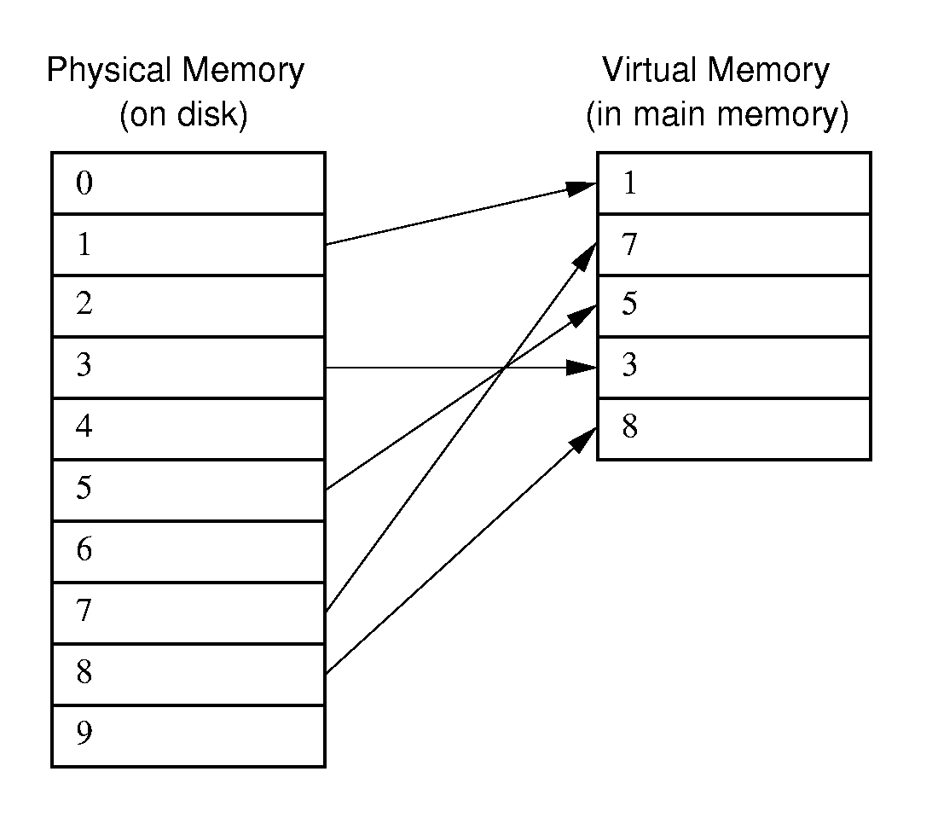
Buffer Pools

Slide 19
Organizing Buffer Pools
Which buffer should be replaced when new data must be read?
First-in, First-out: Use the first one on the queue.
Least Frequently Used (LFU): Count buffer accesses, reuse the least used.
Least Recently used (LRU): Keep buffers on a linked list. When buffer is accessed, bring it to front. Reuse the one at end.

Slide 20
Bufferpool ADT (1)
class BufferPool { // (1) Message Passing
public:
virtual void insert(void* space,
int sz, int pos) = 0;
virtual void getbytes(void* space,
int sz, int pos) = 0;
};
class BufferPool { // (2) Buffer Passing
public:
virtual void* getblock(int block) = 0;
virtual void dirtyblock(int block) = 0;
virtual int blocksize() = 0;
};

Slide 21
Design Issues
Disadvantage of message passing:
  Messages are copied and passed back and forth.
Disadvantages of buffer passing:
  The user is given access to system memory (the buffer itself)
  The user must explicitly tell the buffer pool when buffer contents have been modified, so that modified data can be rewritten to disk when the buffer is flushed.
  The pointer might become stale(过时) when the bufferpool replaces the contents of a buffer.

Slide 22
Programmer’s View of Files
Logical view of files:
  An a array of bytes.
  A file pointer marks the current position.
Three fundamental operations:
  Read bytes from current position (move file pointer)
  Write bytes to current position (move file pointer)
  Set file pointer to specified byte position.

Slide 23
C++ File Functions
#include <fstream.h>
void fstream::open(char* name, openmode mode);
  Example: ios::in | ios::binary
void fstream::close();
fstream::read(char* ptr, int numbytes);
fstream::write(char* ptr, int numbtyes);
fstream::seekg(int pos);
fstream::seekg(int pos, ios::curr);
fstream::seekp(int pos);
fstream::seekp(int pos, ios::end);

Slide 24
External Sorting
Problem: Sorting data sets too large to fit into main memory.
  Assume data are stored on disk drive.
To sort, portions of the data must be brought into main memory, processed, and returned to disk.
An external sort should minimize disk accesses.

Slide 25
Model of External Computation
Secondary memory is divided into equal-sized blocks (512, 1024, etc…)
A basic I/O operation transfers the contents of one disk block to/from main memory.
Under certain circumstances, reading blocks of a file in sequential order is more efficient. (When?)
Primary goal is to minimize I/O operations.
Assume only one disk drive is available.
Notes:
For sequential search to be more efficient than random access to the file
adjacent logical blocks of the file must be physically adjacent.
There must be no competition for the I/O head, either with another process, or within the same process (such as thrashing between and input buffer and an output buffer).

Slide 26
Key Sorting
Often, records are large, keys are small.
  Ex: Payroll entries keyed on ID number
Approach 1: Read in entire records, sort them, then write them out again.
Approach 2: Read only the key values, store with each key the location on disk of its associated record.
After keys are sorted the records can be read and rewritten in sorted order.
Notes:
Usually the records are not rewritten in sorted order.
(1) It is expensive (random access to all records).
(2) If there are multiple keys, there is no single “correct” order.

Slide 27
Simple External Mergesort (1)
Quicksort requires random access to the entire set of records.
Better: Modified Mergesort algorithm.
  Process n elements in Θ(log n) passes.
A group of sorted records is called a run.
Notes:
Usually the records are not rewritten in sorted order.
(1) It is expensive (random access to all records).
(2) If there are multiple keys, there is no single “correct” order.

Slide 28
Simple External Mergesort (2)
Split the file into two files.
Read in a block from each file.
Take first record from each block, output them in sorted order.
Take next record from each block, output them to a second file in sorted order.
Repeat until finished, alternating between output files. Read new input blocks as needed.
Repeat steps 2-5, except this time input files have runs of two sorted records that are merged together.
Each pass through the files provides larger runs.
Notes:
Usually the records are not rewritten in sorted order.
(1) It is expensive (random access to all records).
(2) If there are multiple keys, there is no single “correct” order.

Slide 29
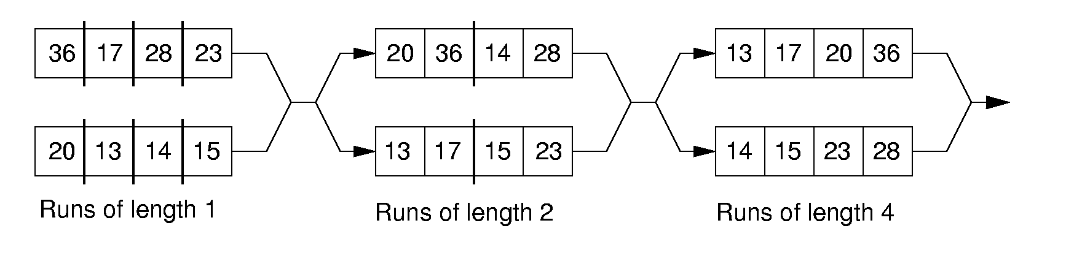
Simple External Mergesort (3)
Notes:
Usually the records are not rewritten in sorted order.
(1) It is expensive (random access to all records).
(2) If there are multiple keys, there is no single “correct” order.

Slide 30
Problems with Simple Mergesort
Is each pass through input and output files sequential?
What happens if all work is done on a single disk drive?
How can we reduce the number of Mergesort passes?
In general, external sorting consists of two phases:
  Break the files into initial runs
  Merge the runs together into a single run.
Notes:
The passes are sequential. But, on a single disk drive, competition for the I/O head eliminates this advantage.
But, we can get a massive improvement by reading in a block, or several blocks, and using an in-memory sort to create the initial runs.

Slide 31
Breaking a File into Runs
General approach:
  Read as much of the file into memory as possible.
  Perform an in-memory sort.
  Output this group of records as a single run.

Slide 32
Replacement Selection (1)
Break available memory into an array for the heap, an input buffer, and an output buffer.
Fill the array from disk.
Make a min-heap.
Send the smallest value (root) to the output buffer.

Slide 33
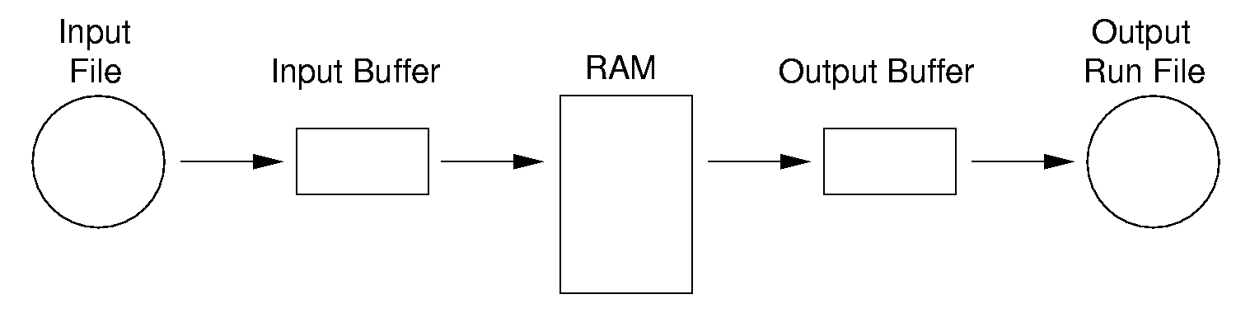
Replacement Selection (2)
If the next key in the file is greater than the last value output, then
  Replace the root with this key
  else
  Replace the root with the last key in the array
  Add the next record in the file to a new heap (actually, stick it at the end of the array).

Slide 34
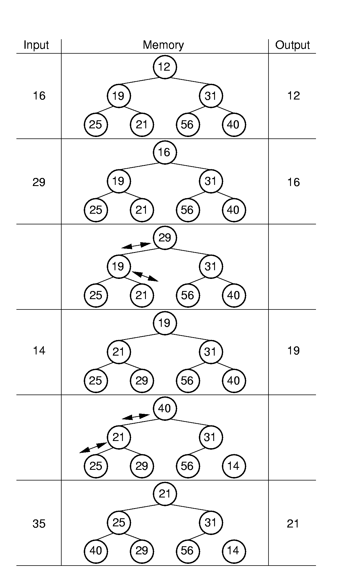
RS Example

Slide 35
Snowplow Analogy (1)
Imagine a snowplow moving around a circular track on which snow falls at a steady rate.
At any instant, there is a certain amount of snow S on the track. Some falling snow comes in front of the plow, some behind.
During the next revolution of the plow, all of this is removed, plus 1/2 of what falls during that revolution.
Thus, the plow removes 2S amount of snow.
Notes:
How many disk drives do we need for the greatest benefit? Two -- one for input, one for output.

Slide 36
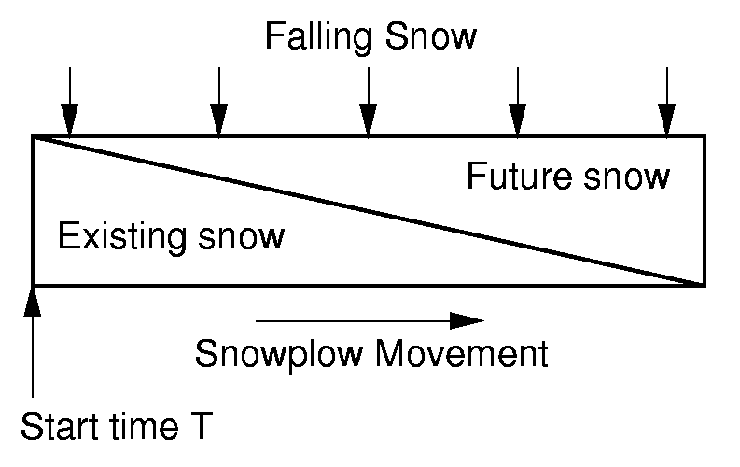
Snowplow Analogy (2)

Slide 37
Problems with Simple Merge
Simple mergesort: Place runs into two files.
  Merge the first two runs to output file, then next two runs, etc.
Repeat process until only one run remains.
  How many passes for r initial runs?
Is there benefit from sequential reading?
Is working memory well used?
Need a way to reduce the number of passes.
Notes:
For r initial runs, need log r passes.
We get NO benefit from sequential reading if only one disk drive is used.
Working memory is poorly used because only 2 blocks are really needed. So, we would like a way to use memory better.

Slide 38
Multiway Merge (1)
With replacement selection, each initial run is several blocks long.
Assume each run is placed in separate file.
Read the first block from each file into memory and perform an r-way merge.
When a buffer becomes empty, read a block from the appropriate run file.
Each record is read only once from disk during the merge process.

Slide 39
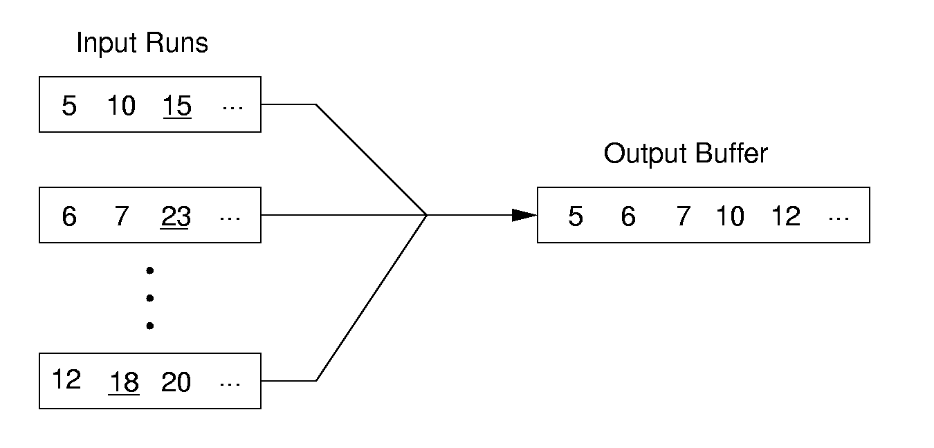
Multiway Merge (2)
In practice, use only one file and seek to appropriate block.

Slide 40
Limits to Multiway Merge (1)
Assume working memory is b blocks in size.
How many runs can be processed at one time?
The runs are 2b blocks long (on average).
How big a file can be merged in one pass?
Notes:
Merge b runs at one time (one block allocated to each run). Replacement selection makes the runs 2b blocks long on average.

Slide 41
Limits to Multiway Merge (2)
Larger files will need more passes -- but the run size grows quickly!
This approach trades (log b) (possibly) sequential passes for a single or very few random (block) access passes.
Notes:
In k merge passes, we process 2b^{(k+1)} blocks.
Example: 0.5MB working memory, 4KB blocks, yield 128 blocks for working memory. Average run size is 1MB, so 128MB can be sorted in one pass on average. 16GB in two merge passes.

Slide 42
General Principles
A good external sorting algorithm will seek to do the following:
  Make the initial runs as long as possible.
  At all stages, overlap input, processing and output as much as possible.
  Use as much working memory as possible. Applying more memory usually speeds processing.
  If possible, use additional disk drives for more overlapping of processing with I/O, and allow for more sequential file processing.
Notes:
Overlapping input, processing, and output is sometimes called double buffering. Not all operating systems allow this at the programmer’s level.

Slide 43
Sorting
Each record contains a field called the key.
  Linear order: comparison.
Measures of cost:
  Comparisons
  Swaps
  are the main operations of sorting

